Slide 1

EAST POINT COLLEGE OF ENGINEERING & TECHNOLOGY
Department of Computer Science and Engineering (IoT&CSBT)
BIC685 - Project Presentation
Project Title: “Safe Alert: A Secure Crime Tip-Off and Reporting System”
By:
M Prem Venkat (1EP22IC029)
Nisha K (1EP22IC035)
Niveditha C (1EP22IC036)
Syeda Saniya Khazi (1EP22IC054)
Under the Guidance of
Dr. Nanda Ashwin
Prof & HOD, Dept. of CSE (IoT & CSBT)
Project Commitee
Dr. Komala C R
Professor, Dept. of CSE (IoT & CSBT)
Dr. Nanda Ashwin
Prof & HOD, Dept. of CSE (IoT & CSBT)

Slide 2
Presentation Outline
System Architecture
Identification of System Components
Problems Encountered and Solutions
Expected Outcome
Conclusion
References

Slide 3
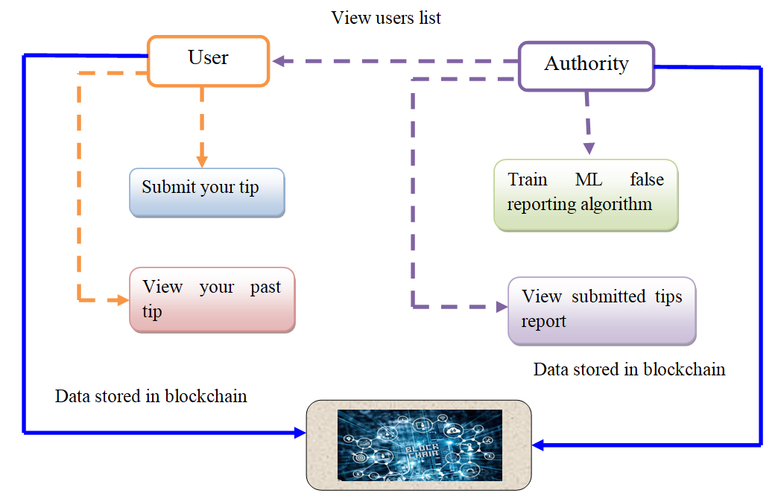
SYSTEM ARCHITECTURE

Slide 4
IDENTIFICATION OF SYSTEM COMPONENTS
User Interface (UI): Web or mobile interface for user registration, login, and tip-off submission.
Backend Server: Handles requests, performs validations, and communicates with the blockchain.
Blockchain Layer: Stores critical data such as anonymous tip-offs immutably.
Smart Contracts: Enforce rules, store data securely, and facilitate communication between users and authorities.
Authority Dashboard: Interface for crime authorities to review, validate, and act on the information.

Slide 5
PROBLEMS ENCOUNTERED AND SOLUTIONS
Keeping Users Anonymous
Problem: We didn’t want to store any personal information that could reveal who sent the tip.
Solution: We used special codes (hashing) instead of real names or details, so users stayed anonymous and safe.
Tip Submission Was Slow
Problem: It took time for the blockchain to confirm that the tip was submitted, which confused users.
Solution: We added a loading message and showed users the status of their submission so they knew it was working.
High Blockchain Costs
Problem: Saving too much data on the blockchain was expensive (in terms of gas fees).
Solution: We changed the smart contract to use less storage and used cheaper networks like Polygon testnet for testing.
Keeping the Authority Dashboard Secure
Problem: We didn’t want unauthorized people to access sensitive tip information.
Solution: We added password protection, secure logins, and only allowed approved officials to access the dashboard.

Slide 6
EXPECTED OUTCOME
Safe Tip-Off System: A secure, decentralized platform for citizens to report crimes anonymously where people will be able to report crimes or suspicious activities without revealing their identity.
Trust in the System: Since the system uses blockchain, all information is secure, unchangeable, and can’t be tampered with.
Faster Action by Authorities: Authorities will get tips directly through their dashboard and can act quickly on real cases.
Less Fear, More Reporting: Because users stay anonymous, more people may come forward to report crimes without fear.

Slide 7
CONCLUSION
The project provides a robust platform that allows witnesses to report suspicious activities anonymously, ensuring their safety while enhancing collaboration with law enforcement.
By leveraging Ethereum blockchain, the system ensures that crime reports remain immutable and tamper-proof, fostering trust between users and authorities.
The TensorFlow CNN model improves the credibility of reported tips by analyzing and predicting their authenticity, helping authorities prioritize genuine cases efficiently.
With IPFS for decentralized multimedia storage, the system securely handles evidence, preserving crucial information for investigations.
By integrating encryption, blockchain, machine learning, Ganache, and MetaMask, the system enhances the security, efficiency, and accuracy of crime reporting, contributing to faster responses from authorities and ultimately safer communities.

Slide 8
REFERENCES
Burke Mark-John and Kayem Anne V.D.M., (2014) “K-Anonymity for Privacy Preserving Crime Data Publishing in Resource Constrained Environments”, May 13-16, 2014.
Jensen, K. L., Iipito, H. N., Onwordi, M. U. and Mukumbira, S. “Toward an mPolicing solution for Namibia: leveraging emerging mobile platforms and crime mapping”, 2012.
Lasley, J.R. and Palombo, B.J. “When crime reporting goes high-tech: An experimental test of computerized citizen response to crime”, 1996.
P. Mahalakshmi, S. Thenmalar, "Feature Based Training for Crime Detection using Deep Learning Techniques“, 2023.
Uma N, "Deep Convolutional Generative Adversarial Networks for Crime Scene Object Detection", 2023.

